Slide 1



Welcome To
Tiffin services
Ghar ka khana

Slide 2

Welcome To
Tiffin services
Ghar ka khana

Slide 3
Ghar ka khana
Points Are I Talking About
Introduction
key features
Additional Functionalities
Market research

Slide 4
Ghar ka khana
Introduction
It seems like you're describing a platform or service called
"Ghar Ka Khana" that aims to help people find local tiffin
services easily, especially when they move to a new city
for work or study. Here's a corrected version of your text:
key features
Additional Functionalities
Market research
1
2
3
4

Slide 5
Ghar ka khana
Introduction
It seems like you're describing a platform or service called
"Ghar Ka Khana" that aims to help people find local tiffin
services easily, especially when they move to a new city
for work or study. Here's a corrected version of your text:
1
2
3
4

Slide 6

"Nowadays”, many people move to another city for work or study
without knowing much about the area. They may find good paying
guest accommodations or flats, but finding good food services can
be challenging. While online food ordering is an option, it may not
always provide the home-cooked food experience that many prefer.
Ghar ka khana
Introduction
key features
Additional Functionalities
Market research
It seems like you're describing a platform or service called
"Ghar Ka Khana" that aims to help people find local tiffin
services easily, especially when they move to a new city
for work or study. Here's a corrected version of your text:
1
2
3
4

Slide 7
Ghar ka khana
To address this, we have created a website called 'Ghar Ka Khana.’
On this platform, all tiffin service providers are listed, making
it easier for users to find them. Additionally, users can search for
tiffin services available in their area or location.
Introduction
key features
Additional Functionalities
Market research
"Nowadays”, many people move to another city for work or study
without knowing much about the area. They may find good paying
guest accommodations or flats, but finding good food services can
be challenging. While online food ordering is an option, it may not
always provide the home-cooked food experience that many prefer.
It seems like you're describing a platform or service called
"Ghar Ka Khana" that aims to help people find local tiffin
services easily, especially when they move to a new city
for work or study. Here's a corrected version of your text:
2
1
3
4

Slide 8
Ghar ka khana
Currently, there are many popular tiffin services, but they may not
always offer customized meals or easy cancellation options. Sometimes,
these services may not be available in certain areas. 'Ghar Ka Khana’
aims to overcome these drawbacks by providing a convenient and
reliable platform for finding tiffin services that meet users' needs."
Introduction
key features
Additional Functionalities
Market research
To address this, we have created a website called 'Ghar Ka Khana.’
On this platform, all tiffin service providers are listed, making
it easier for users to find them. Additionally, users can search for
tiffin services available in their area or location.
"Nowadays”, many people move to another city for work or study
without knowing much about the area. They may find good paying
guest accommodations or flats, but finding good food services can
be challenging. While online food ordering is an option, it may not
always provide the home-cooked food experience that many prefer.
3
1
2
4

Slide 9
Ghar ka khana
Introduction
key features
Additional Functionalities
Market research
Currently, there are many popular tiffin services, but they may not
always offer customized meals or easy cancellation options. Sometimes,
these services may not be available in certain areas. 'Ghar Ka Khana’
aims to overcome these drawbacks by providing a convenient and
reliable platform for finding tiffin services that meet users' needs."
To address this, we have created a website called 'Ghar Ka Khana.’
On this platform, all tiffin service providers are listed, making
it easier for users to find them. Additionally, users can search for
tiffin services available in their area or location.
4
1
2
3

Slide 10
Ghar ka khana
User Registration and Login
Users can create an account and log in to access the platform's features.
Tiffin service providers can register their services on the platform, providing
details such as menu, pricing, delivery areas, etc.
Tiffin Service Provider Registration
Search and Filter
Users can search for tiffin services based on location, cuisine, pricing, and other
filters to find the best options in their area.
Interactive Map
Key Features
An interactive map feature will display all available tiffin services in the user's area,
making it easy to compare and choose.
Reviews and Ratings
Users can rate and review tiffin services based on their experience, helping
others make informed decisions.
Currently, there are many popular tiffin services, but they may not
always offer customized meals or easy cancellation options. Sometimes,
these services may not be available in certain areas. 'Ghar Ka Khana’
aims to overcome these drawbacks by providing a convenient and
reliable platform for finding tiffin services that meet users' needs."
1
2
3
4

Slide 11
Users can place orders directly through the platform, specifying their preferences and
delivery details.
Secure payment integration allows users to pay for their orders online, offering
convenience and safety.
Order Placement
Ghar ka khana
Users can track the status of their orders in real-time, from preparation to delivery.
Payment Integration
User Registration and Login
Order Tracking
Users receive notifications regarding order status, new tiffin services in their area,
and other relevant updates.
Introduction
Users can create an account and log in to access the platform's features.
key features
Notifications
Tiffin Service Provider Registration
A dedicated customer support system ensures that users can get assistance with any
issues or queries they may have.
Additional Functionalities
Customer Support
Tiffin service providers can register their services on the platform, providing
details such as menu, pricing, delivery areas, etc.
Market research
Search and Filter
Users can search for tiffin services based on location, cuisine, pricing, and other
filters to find the best options in their area.
Interactive Map
An interactive map feature will display all available tiffin services in the user's area,
making it easy to compare and choose.
Reviews and Ratings
Users can rate and review tiffin services based on their experience, helping
others make informed decisions.

Slide 12
Ghar ka khana
Order Placement
Introduction
Users can place orders directly through the platform, specifying their preferences and
delivery details.
key features
Additional Functionalities
Payment Integration
Secure payment integration allows users to pay for their orders online, offering
convenience and safety.
Market research
Order Tracking
Users can track the status of their orders in real-time, from preparation to delivery.
Notifications
Users receive notifications regarding order status, new tiffin services in their area,
and other relevant updates.
Customer Support
A dedicated customer support system ensures that users can get assistance with any
issues or queries they may have.
User Registration and Login
Users can create an account and log in to access the platform's features.
Tiffin Service Provider Registration
Tiffin service providers can register their services on the platform, providing
details such as menu, pricing, delivery areas, etc.
Search and Filter
Users can search for tiffin services based on location, cuisine, pricing, and other
filters to find the best options in their area.
Interactive Map
An interactive map feature will display all available tiffin services in the user's area,
making it easy to compare and choose.
Reviews and Ratings
Users can rate and review tiffin services based on their experience, helping
others make informed decisions.

Slide 13
Ghar ka khana
Subscription Plans
Customization Options
Diet-Related Tiffin Finds
Offer subscription plans for
regular tiffin service users,
providing discounts and
exclusive offers.
Allow users to customize their tiffin
orders based on dietary preferences,
allergies, etc. Users can also chat
with tiffin service providers to discuss
customization options.
Provide a feature where users can find
tiffin services that cater to specific diets,
such as vegan, gluten-free, keto, etc.
Users can specify their dietary requirements,
and the platform will suggest relevant
tiffin services.
Additional Functionalities
Promotions and Discounts
Group Ordering
Provide promotional offers and discounts
to incentivize users to try new tiffin services.
Enable group ordering for offices
or groups of friends, making it
easier to order in bulk.
Order Placement
Users can place orders directly through the platform, specifying their preferences and
delivery details.
Payment Integration
Secure payment integration allows users to pay for their orders online, offering
convenience and safety.
Order Tracking
Users can track the status of their orders in real-time, from preparation to delivery.
Notifications
Users receive notifications regarding order status, new tiffin services in their area,
and other relevant updates.
Customer Support
A dedicated customer support system ensures that users can get assistance with any
issues or queries they may have.

Slide 14
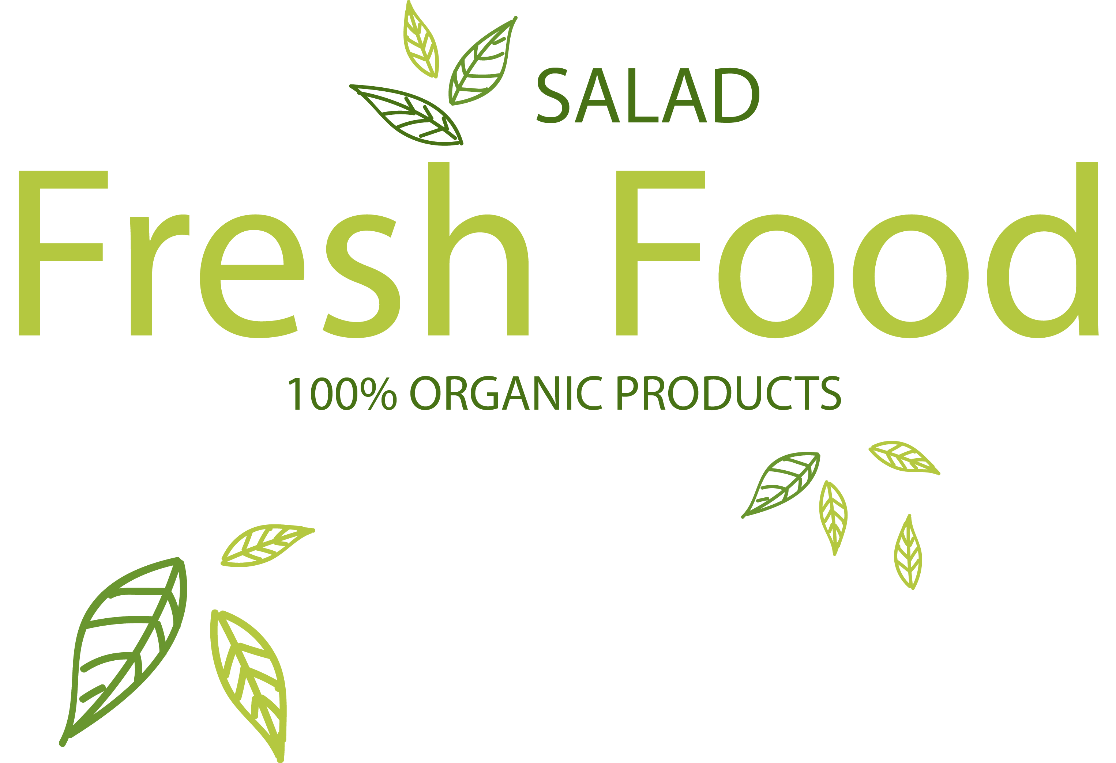
Ghar ka khana
Introduction
Subscription Plans
Customization Options
key features
Offer subscription plans for
regular tiffin service users,
providing discounts and
exclusive offers.
Allow users to customize their tiffin
orders based on dietary preferences,
allergies, etc. Users can also chat
with tiffin service providers to discuss
customization options.
Additional Functionalities
Market research
Diet-Related Tiffin Finds
Group Ordering
Provide a feature where users can find
tiffin services that cater to specific diets,
such as vegan, gluten-free, keto, etc.
Users can specify their dietary requirements,
and the platform will suggest relevant
tiffin services.
Enable group ordering for offices
or groups of friends, making it
easier to order in bulk.
Promotions and Discounts
Provide promotional offers and discounts
to incentivize users to try new tiffin services.

Slide 15
Ghar ka khana
Based on market research, the tiffin service market is currently valued at 2.1
billion and is growing at a rate of approximately 15 to 20% annually. Within
the food market, three main segments are prominent: cloud kitchens,
tiffin services, and cafes/online food ordering.
Market Research
1
2
3
4
5

Slide 16
Ghar ka khana
Introduction
key features
Our focus is on empowering home-based cooks, particularly housewives or independent cooks, who face challenges in reaching customers, especially newcomers to a city, state, or country. Additionally, individuals with health issues or specific dietary preferences can benefit from our platform as it offers customized meal options.
Additional Functionalities
Market research
Based on market research, the tiffin service market is currently valued at 2.1
billion and is growing at a rate of approximately 15 to 20% annually. Within
the food market, three main segments are prominent: cloud kitchens,
tiffin services, and cafes/online food ordering.
1
2
3
4
5

Slide 17
Ghar ka khana
Introduction
key features
While major players like Zomato and Swiggy primarily partner with cafes and restaurants, our platform uniquely partners with home-based cooks, offering a wide range of homemade food options. Unlike other services that are limited to specific areas or cities, we aim to providestate-wise and area-wise tiffin services, ensuring the availability of high-quality homemade food across different regions.
Additional Functionalities
Market research
Our focus is on empowering home-based cooks, particularly housewives or independent cooks, who face challenges in reaching customers, especially newcomers to a city, state, or country. Additionally, individuals with health issues or specific dietary preferences can benefit from our platform as it offers customized meal options.
2
1
3
4
5
Based on market research, the tiffin service market is currently valued at 2.1
billion and is growing at a rate of approximately 15 to 20% annually. Within
the food market, three main segments are prominent: cloud kitchens,
tiffin services, and cafes/online food ordering.

Slide 18
Ghar ka khana
Introduction
key features
Cities like Hyderabad, Bangalore, Mumbai, Ahmedabad, and Pune exhibit strong demand for such services. However, the tiffin service market also presents several challenges, including the presence of numerous competitors, ensuring food quality and quantity, providing a seamless user experience, and managing competition and price sensitivity.
Additional Functionalities
Market research
While major players like Zomato and Swiggy primarily partner with cafes and restaurants, our platform uniquely partners with home-based cooks, offering a wide range of homemade food options. Unlike other services that are limited to specific areas or cities, we aim to providestate-wise and area-wise tiffin services, ensuring the availability of high-quality homemade food across different regions.
3
1
2
4
5
Our focus is on empowering home-based cooks, particularly housewives or independent cooks, who face challenges in reaching customers, especially newcomers to a city, state, or country. Additionally, individuals with health issues or specific dietary preferences can benefit from our platform as it offers customized meal options.

Slide 19
Ghar ka khana
Introduction
key features
Additional Functionalities
Despite these challenges, our platform is designed to address these issues and provide a convenient and reliable solution for both tiffin service providers and customers.
Market research
Cities like Hyderabad, Bangalore, Mumbai, Ahmedabad, and Pune exhibit strong demand for such services. However, the tiffin service market also presents several challenges, including the presence of numerous competitors, ensuring food quality and quantity, providing a seamless user experience, and managing competition and price sensitivity.
4
1
2
3
5
While major players like Zomato and Swiggy primarily partner with cafes and restaurants, our platform uniquely partners with home-based cooks, offering a wide range of homemade food options. Unlike other services that are limited to specific areas or cities, we aim to providestate-wise and area-wise tiffin services, ensuring the availability of high-quality homemade food across different regions.

Slide 20
Ghar ka khana
Introduction
key features
Additional Functionalities
Thank You
Market research
Despite these challenges, our platform is designed to address these issues and provide a convenient and reliable solution for both tiffin service providers and customers.
5
1
2
3
4
Cities like Hyderabad, Bangalore, Mumbai, Ahmedabad, and Pune exhibit strong demand for such services. However, the tiffin service market also presents several challenges, including the presence of numerous competitors, ensuring food quality and quantity, providing a seamless user experience, and managing competition and price sensitivity.

Slide 21
Ghar ka khana
Thank You
for your TIME
5
1
2
3
4
Despite these challenges, our platform is designed to address these issues and provide a convenient and reliable solution for both tiffin service providers and customers.

